Slide 1

The Beginning
Web Development I

Slide 2
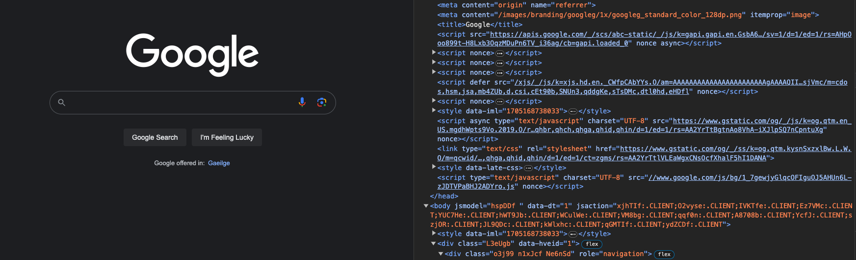
What is HTML?
HTML (HyperText Markup Language) is the most basic building block of the Web. It defines the meaning and structure of web content.
https://developer.mozilla.org/en-US/docs/Web/HTML

Slide 3
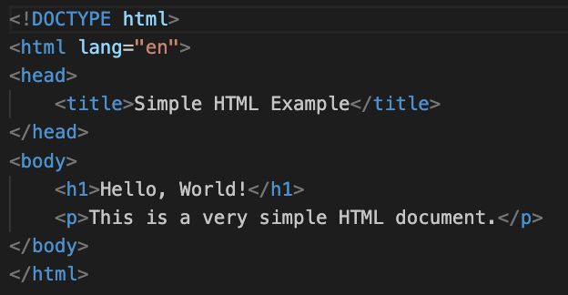
HTML

Slide 4
But that doesn't look like a website!

Slide 5

HTML defines WHAT to render and WHERE to render it
It doesn't really know HOW it'll be rendered
To do that we need..................

Slide 6
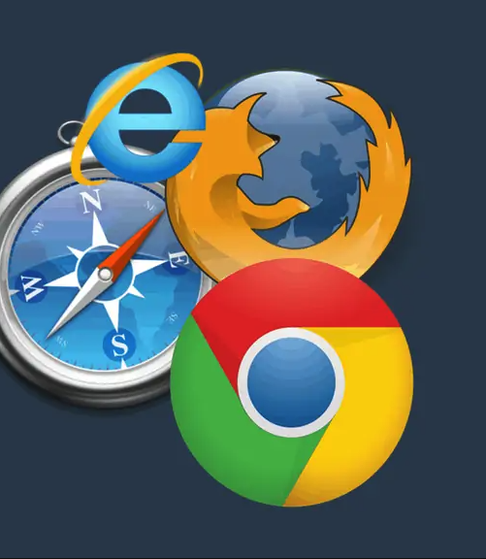
Web Browsers (and CSS but we'll get to that later)

Slide 7
What is a Web Browser?
A web browser is an application that allows users to access and view websites on the internet

Slide 8
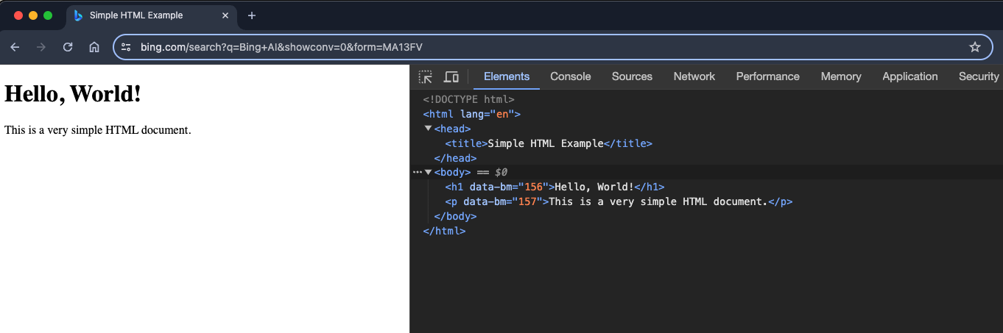

Slide 9
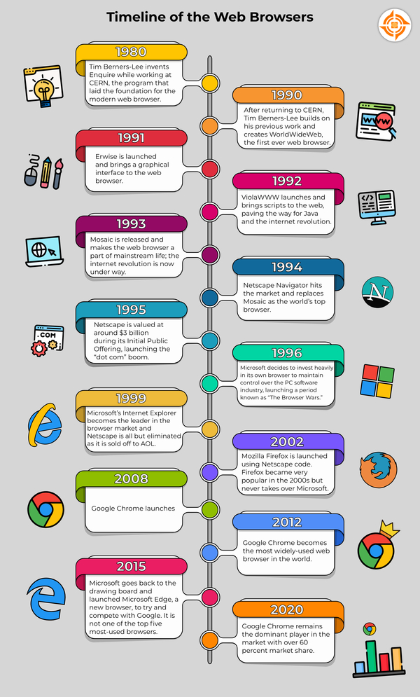
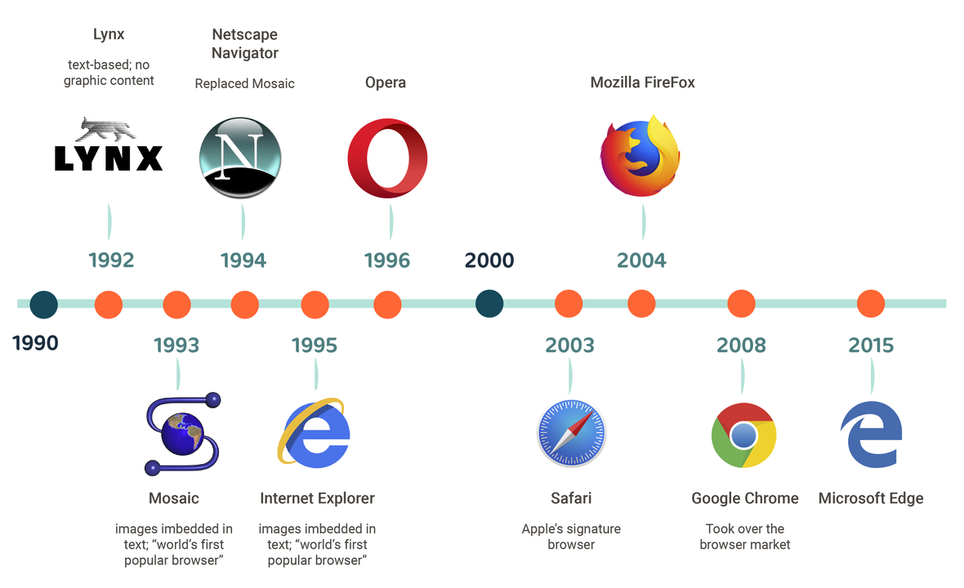

Slide 10
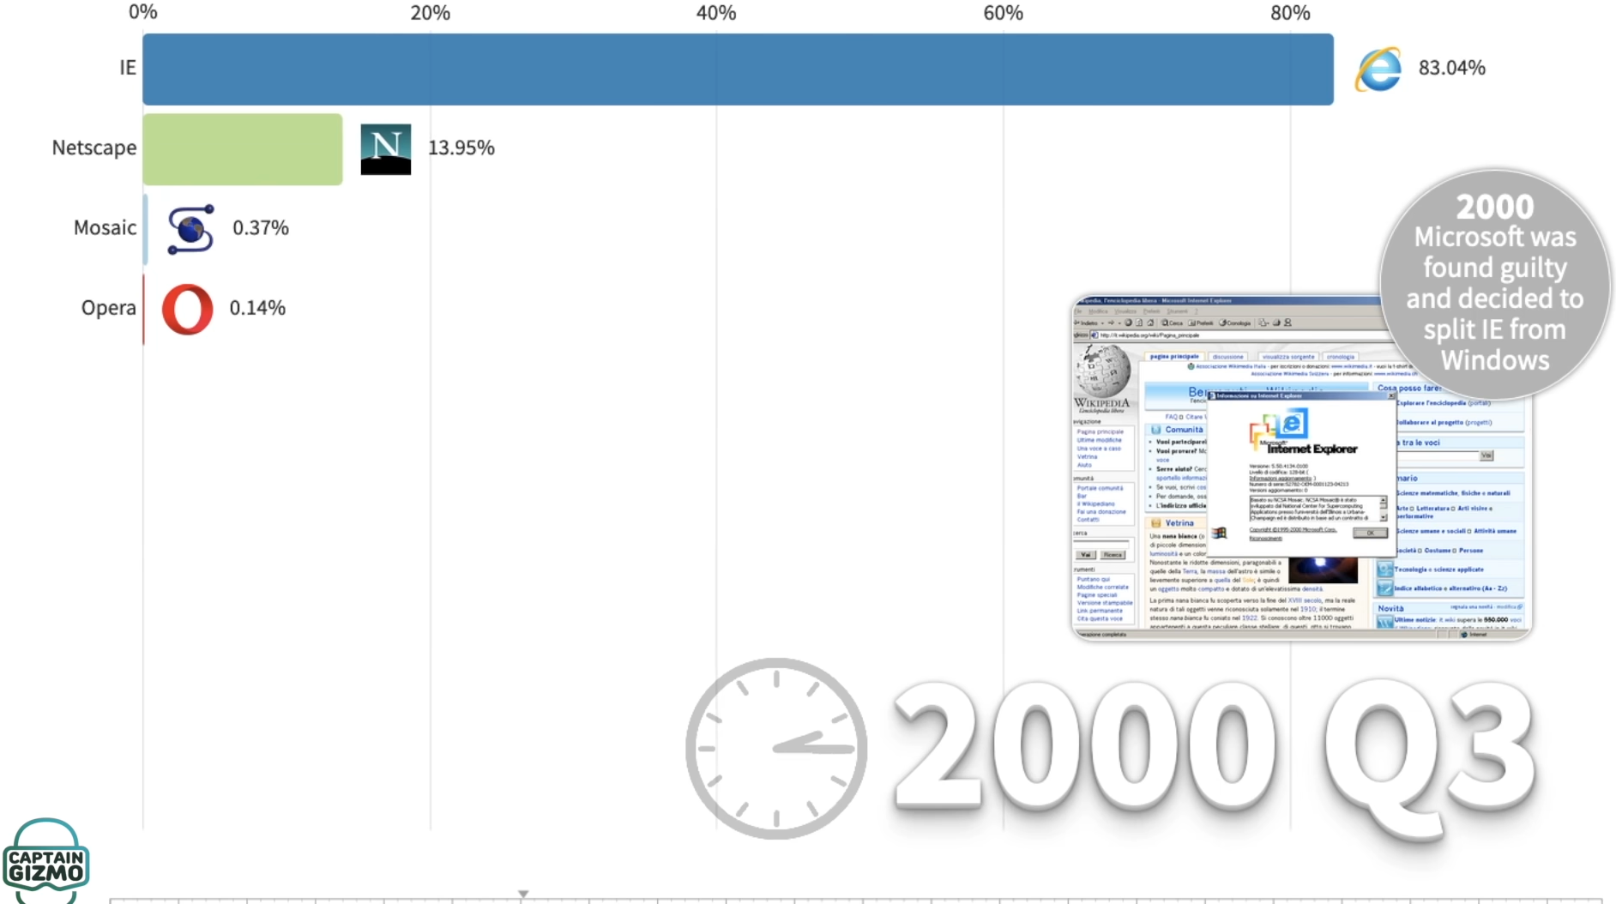

Slide 11
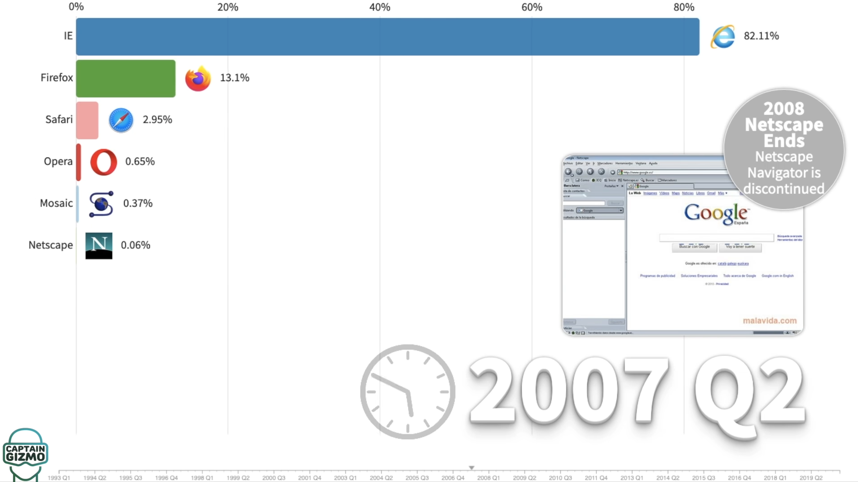

Slide 12
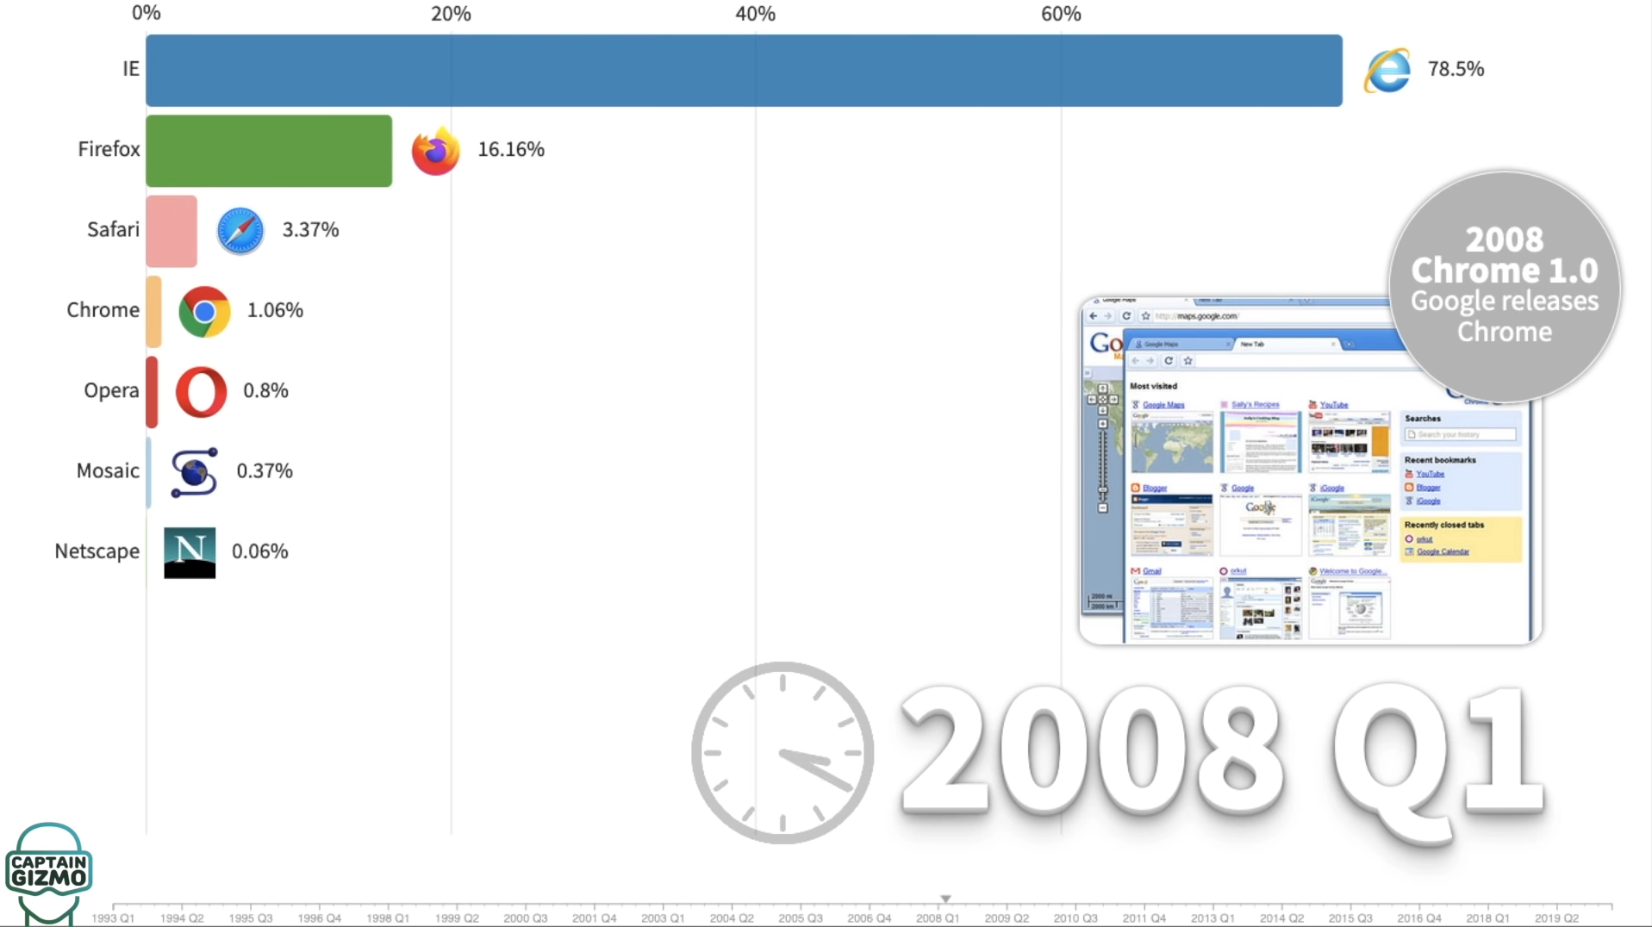

Slide 13
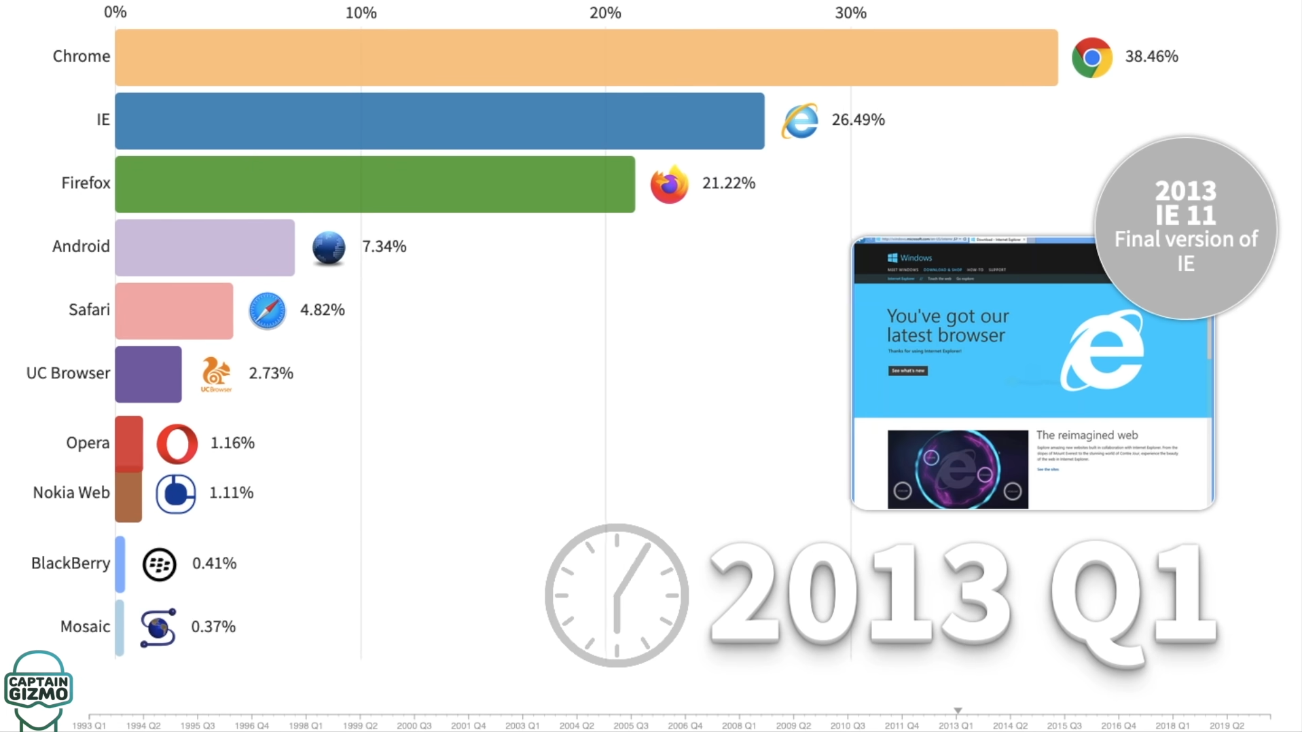
https://www.youtube.com/watch?v=W4wWdmfOibY&t=1s&ab_channel=CaptainGizmo

Slide 14
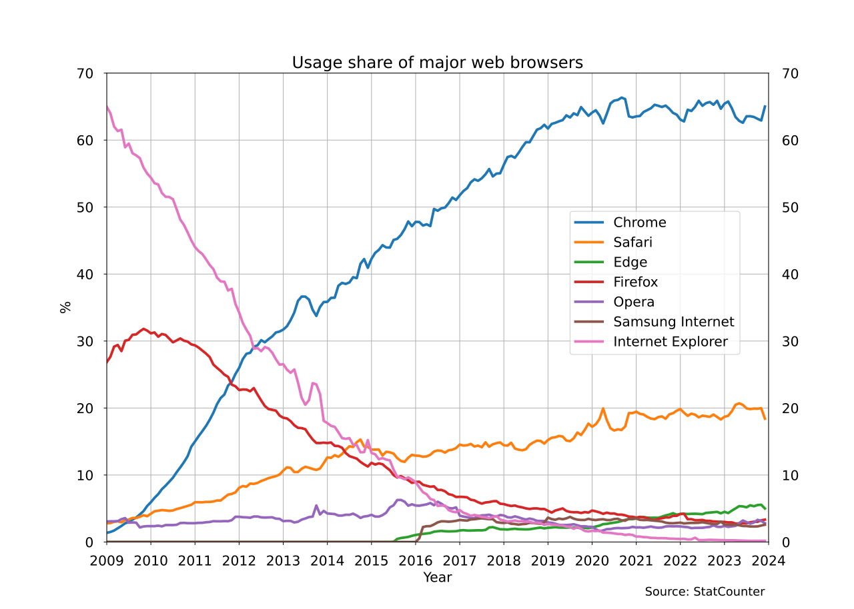

Slide 15

What made Google Chrome so popular?
Google Chrome was initially very popular for people working in the tech space on launch, e.g. Software Developers
This is the case because of a few factors:
The minimalist UI – search and address bar in one (we take for granted now)
JavaScript Performance thanks to the V8 JavaScript Engine – It was FAST
WebGL Support
Chrome Web Store
Rapid Releases allowing adoption of new standards first

Slide 16

The V8 Engine
V8 is a free and open-source JavaScript and WebAssembly engine developed by the Chromium Project for Chromium and Google Chrome web browsers.
The project's creator is Lars Bak.
The first version of the V8 engine was released at the same time as the first version of Chrome: 2 September 2008.

Slide 17

The V8 Engine enabled the creation of Node.js in 2009.
This changed web development on both the front and backend forever (personal opinion ☺ )
Node JS is my preferred way to create APIs and we'll cover in Web Development II

Slide 18
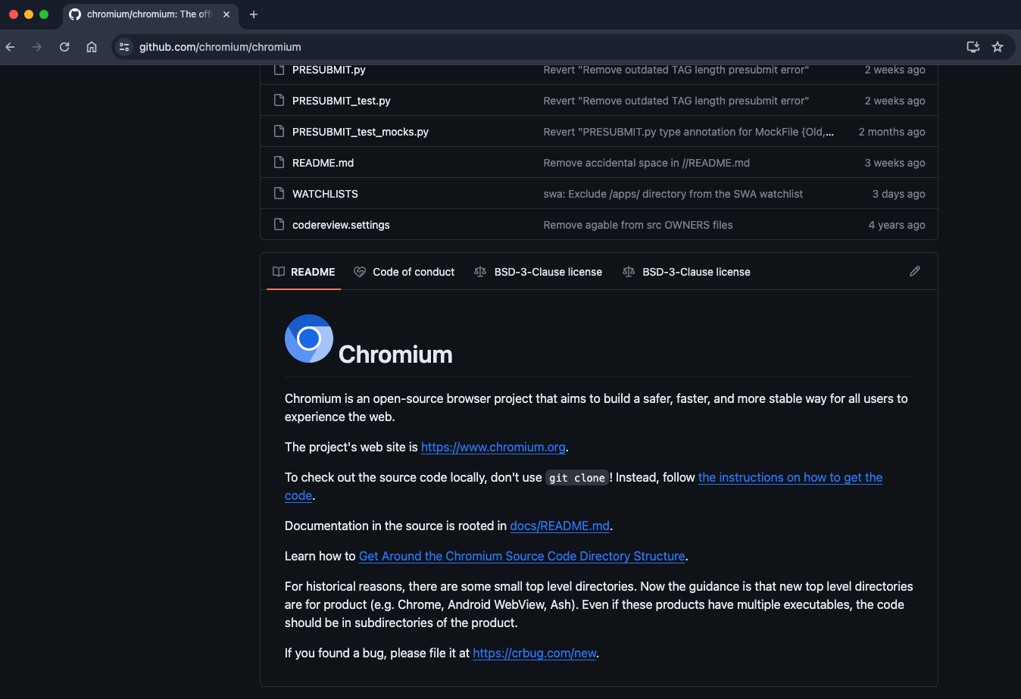
Chromium

Slide 19
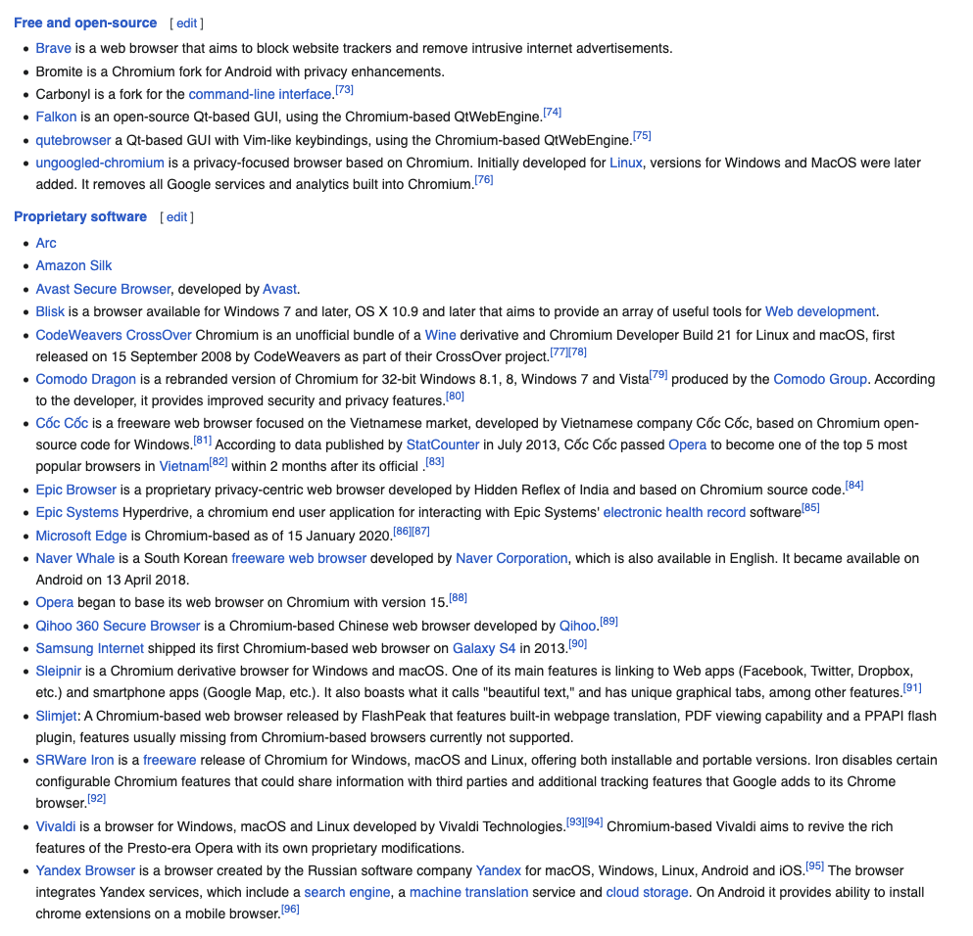

Browsers Based on Chromium

Slide 20

Is that every browser?
No, browsers such as Firefox and Safari are not Chromium Based
Firefox runs on the Quantum browser engine built specifically for Firefox
Safari runs on WebKit

Slide 21
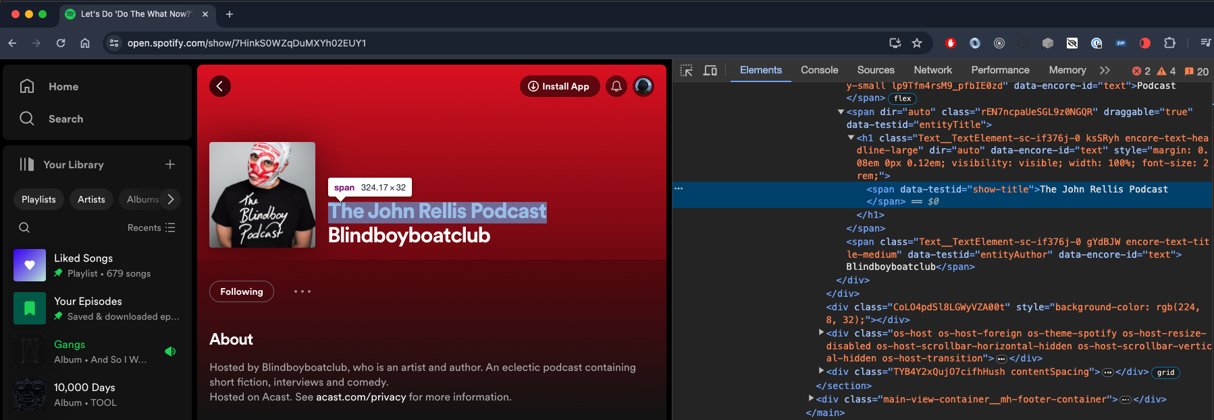
Browsers are now a development tool

Slide 22
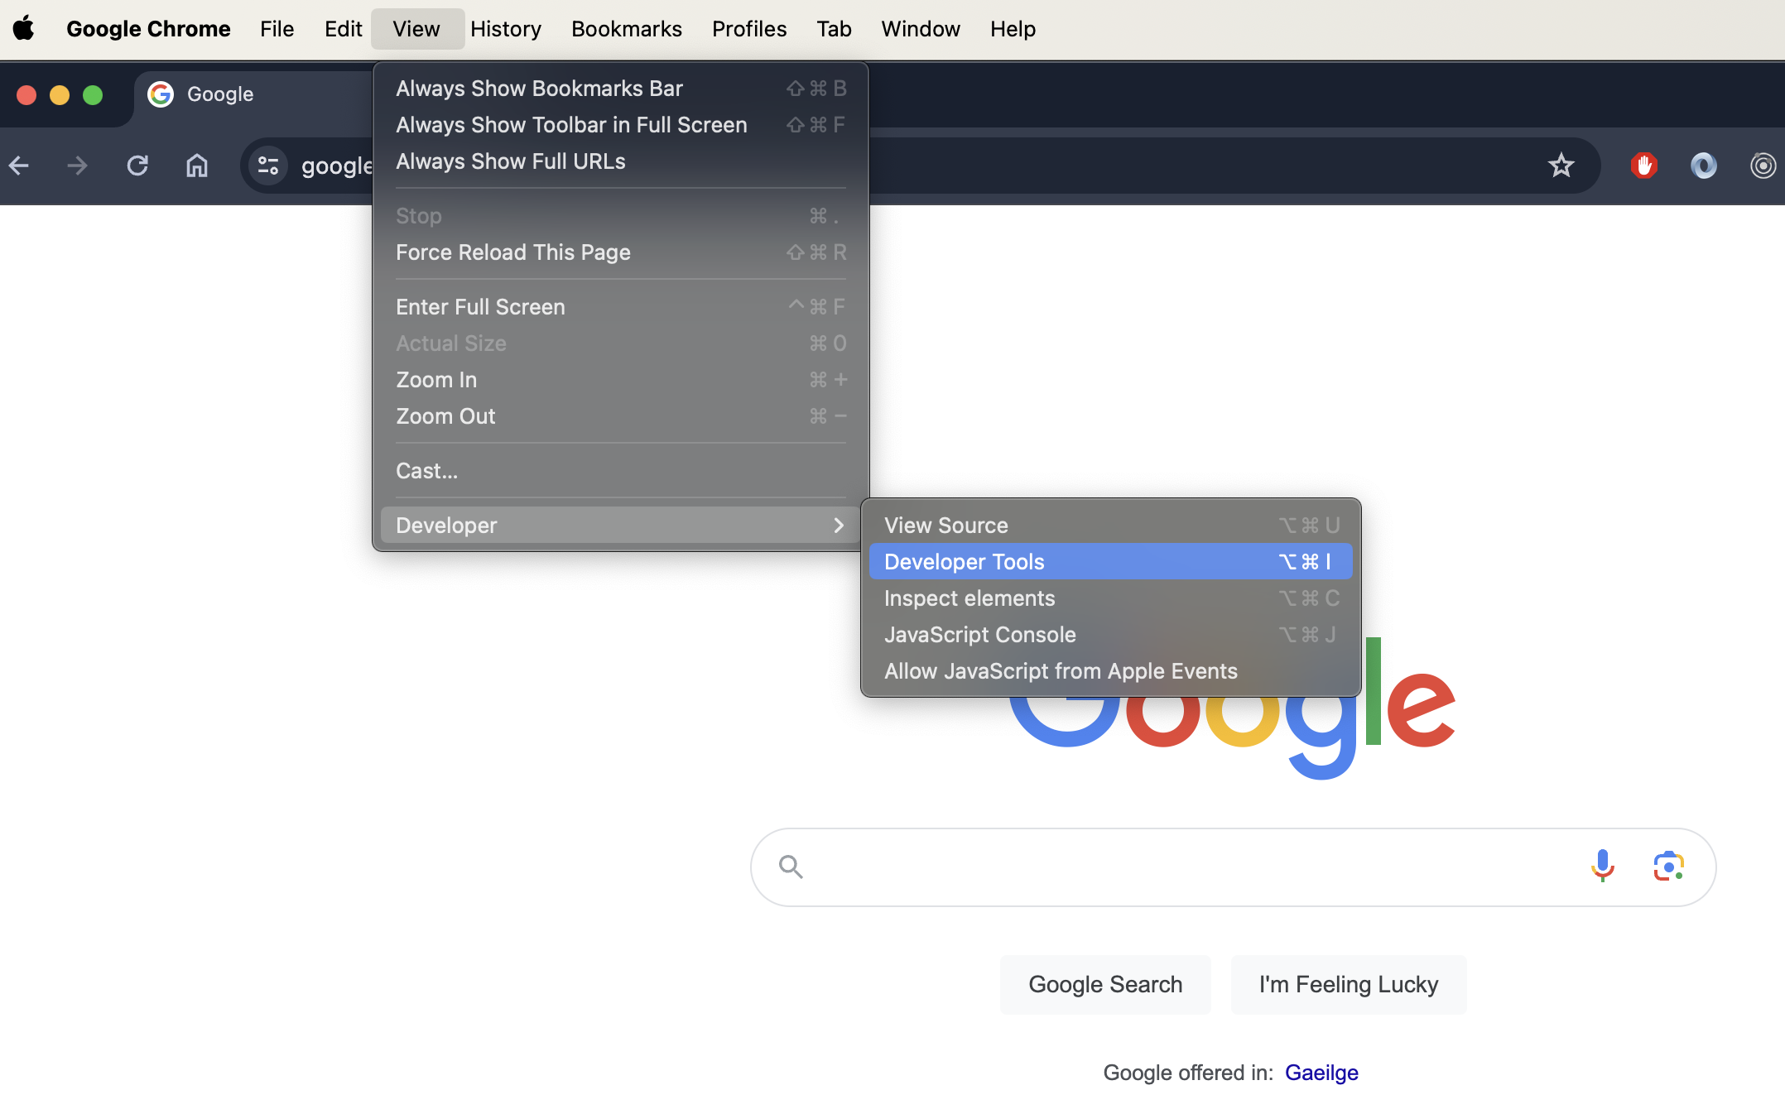
Developer Tools

Slide 23
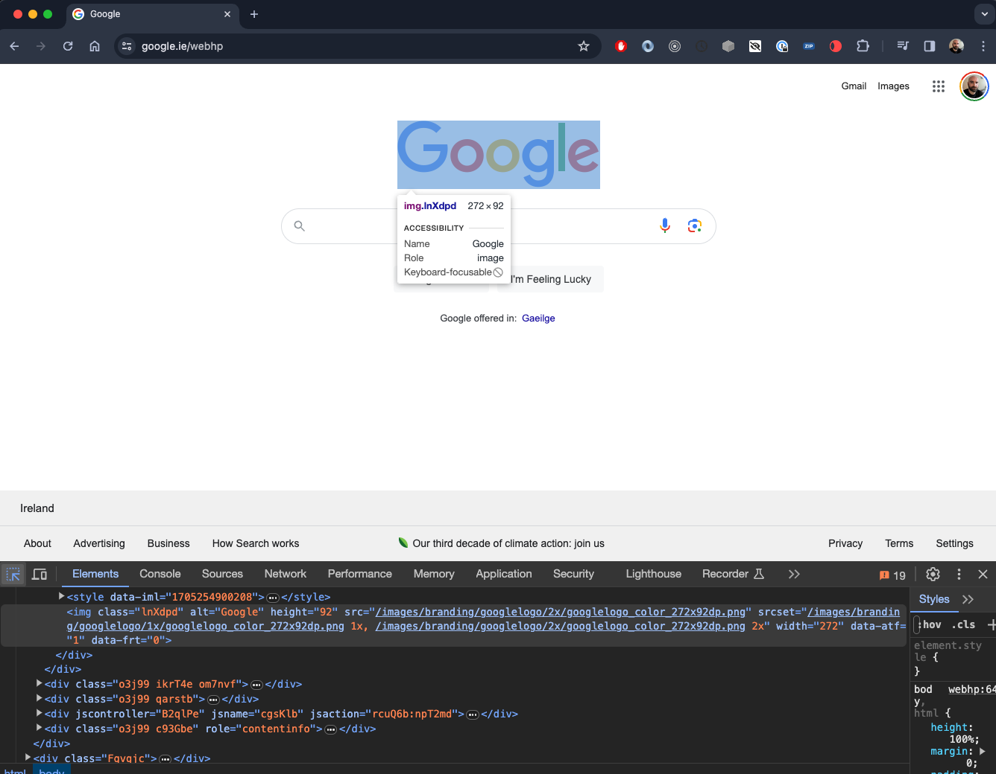

Slide 24

Dev Tools Demo

Slide 25
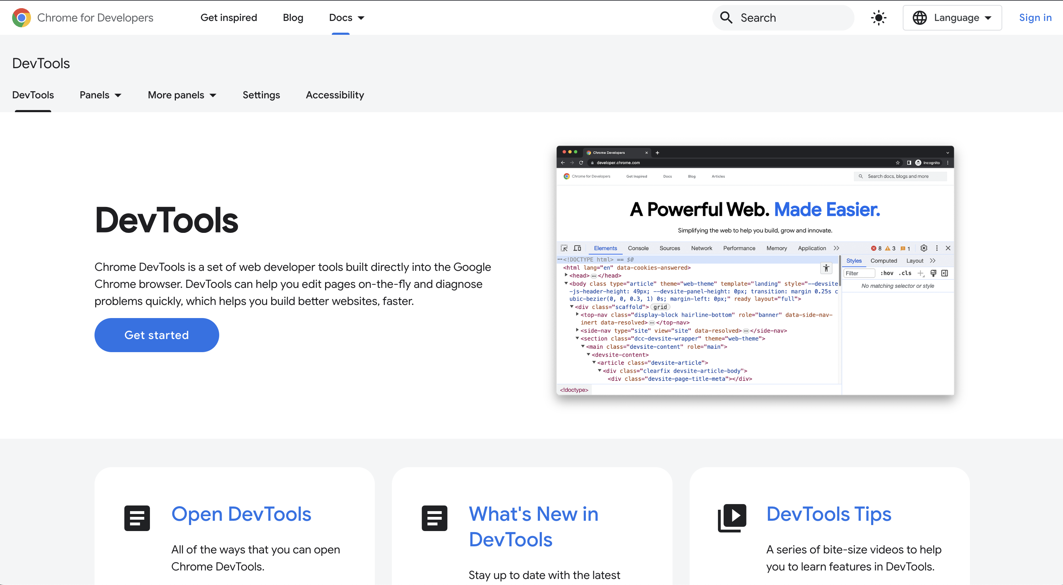
https://developer.chrome.com/docs/devtools

Slide 26
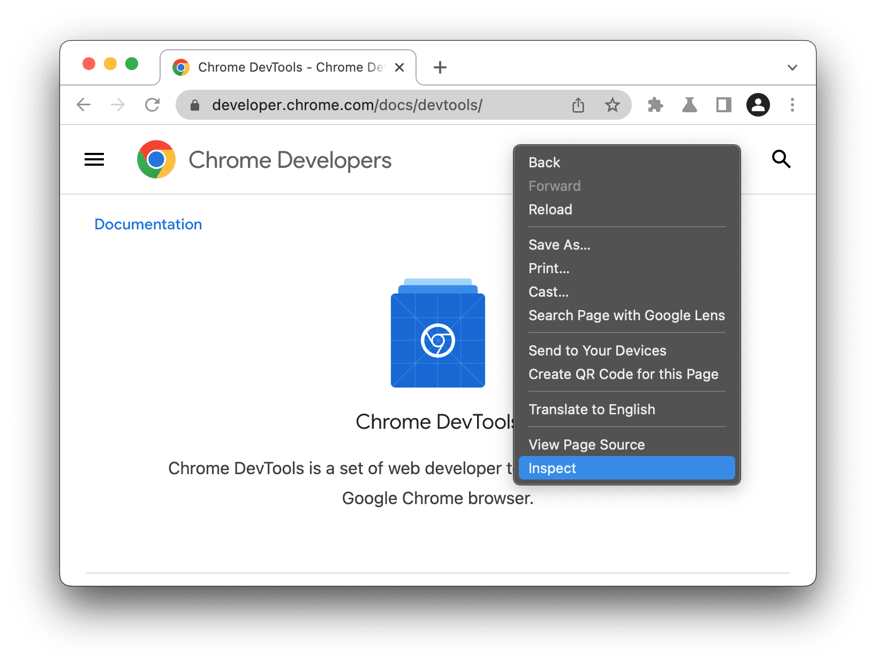
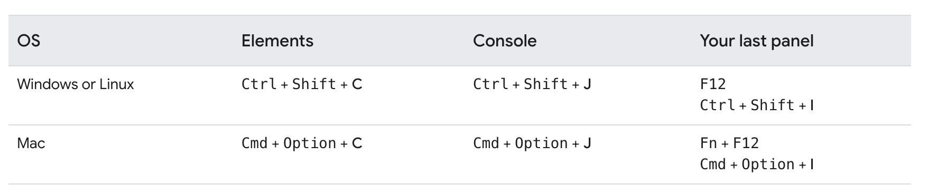
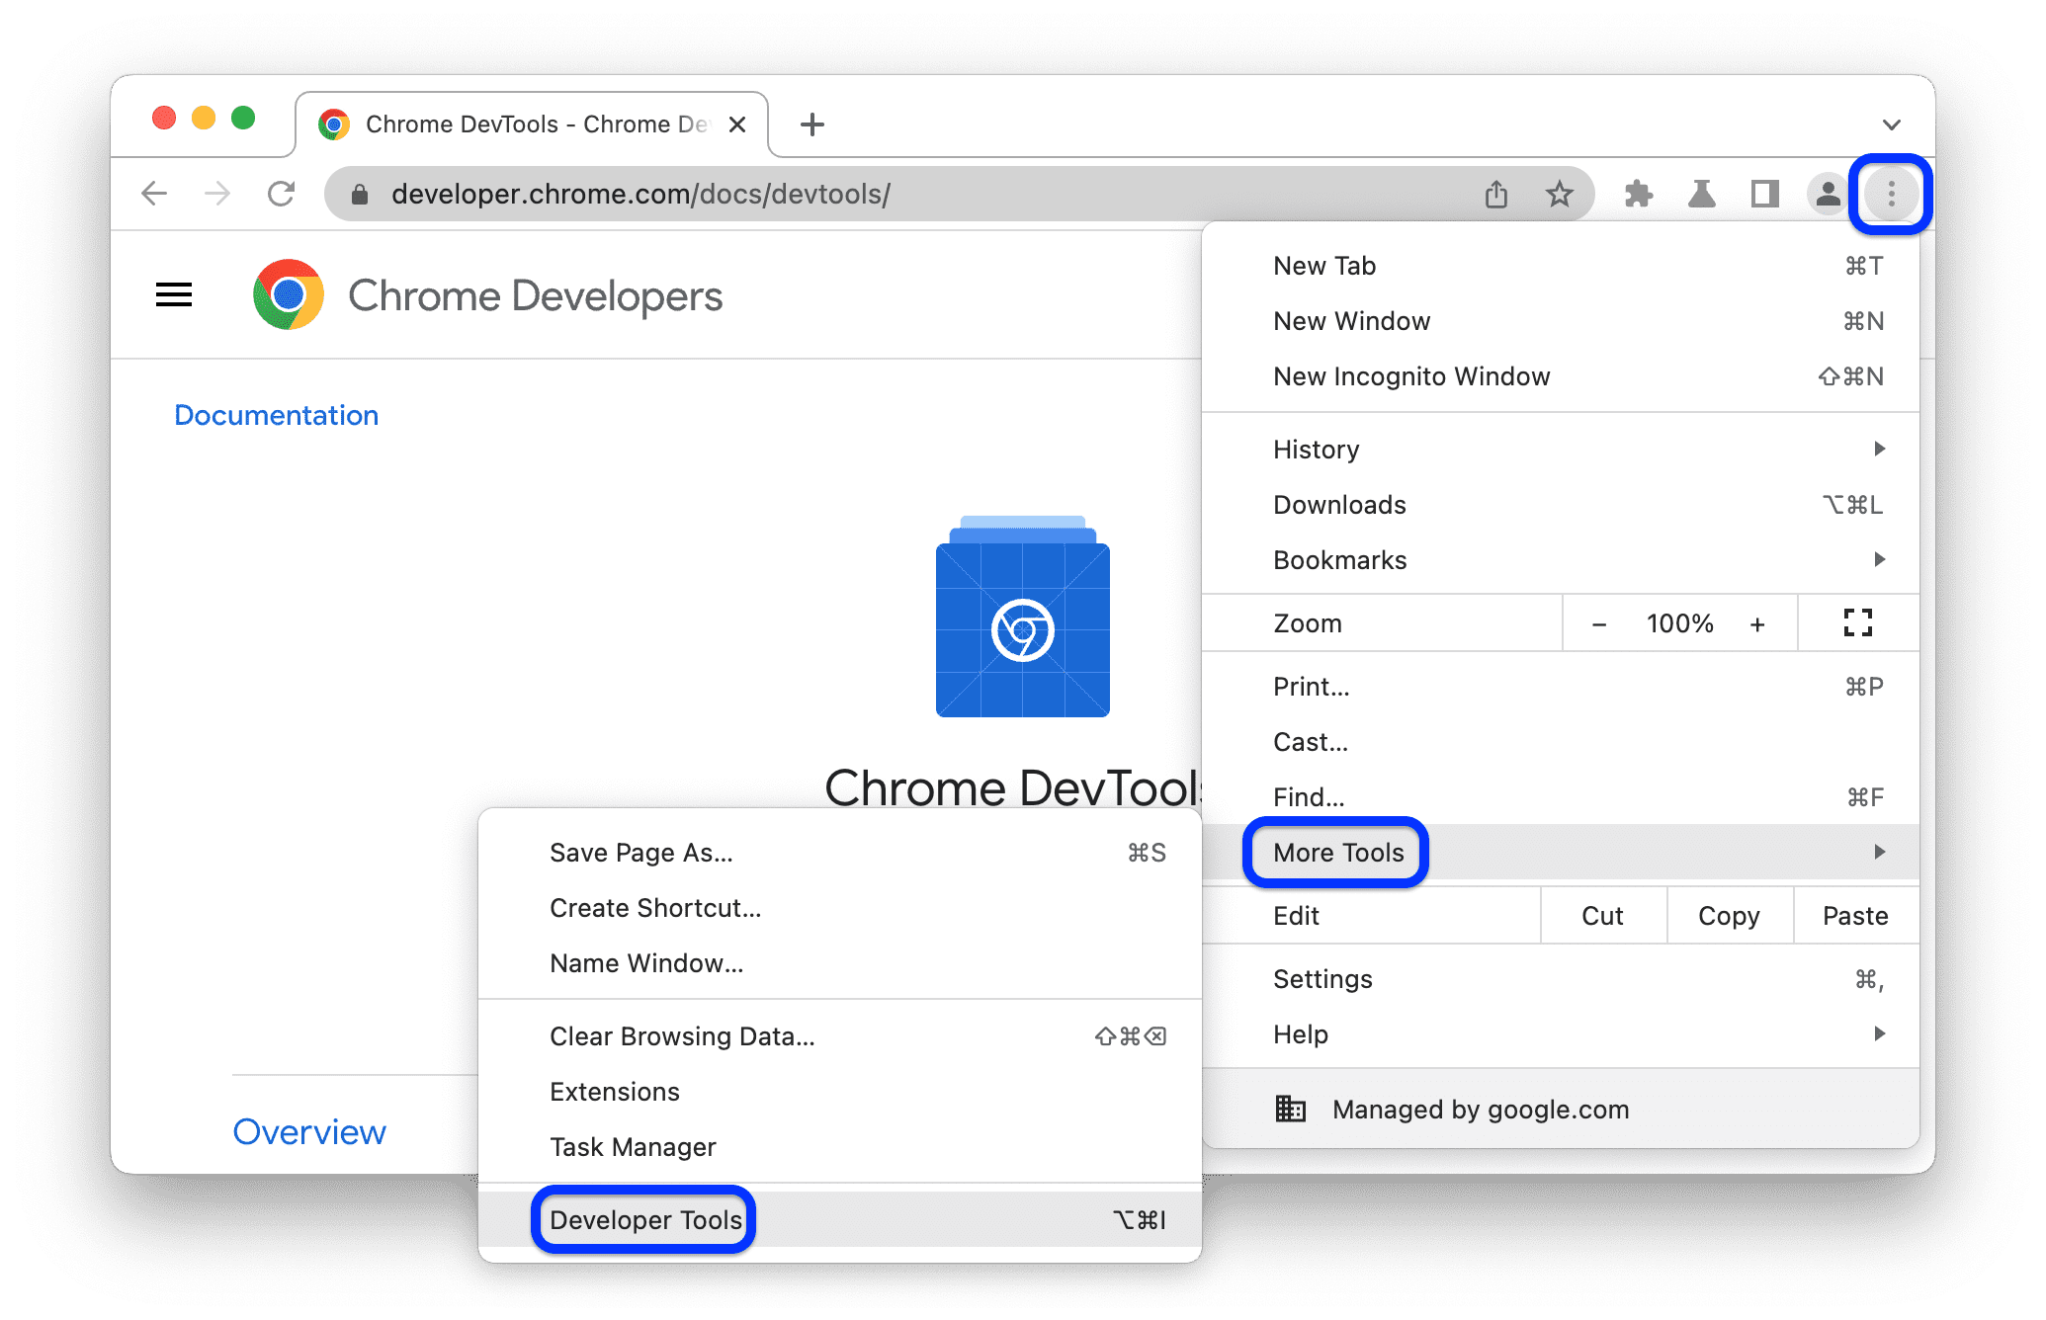
Opening Chrome Dev Tools

Slide 27
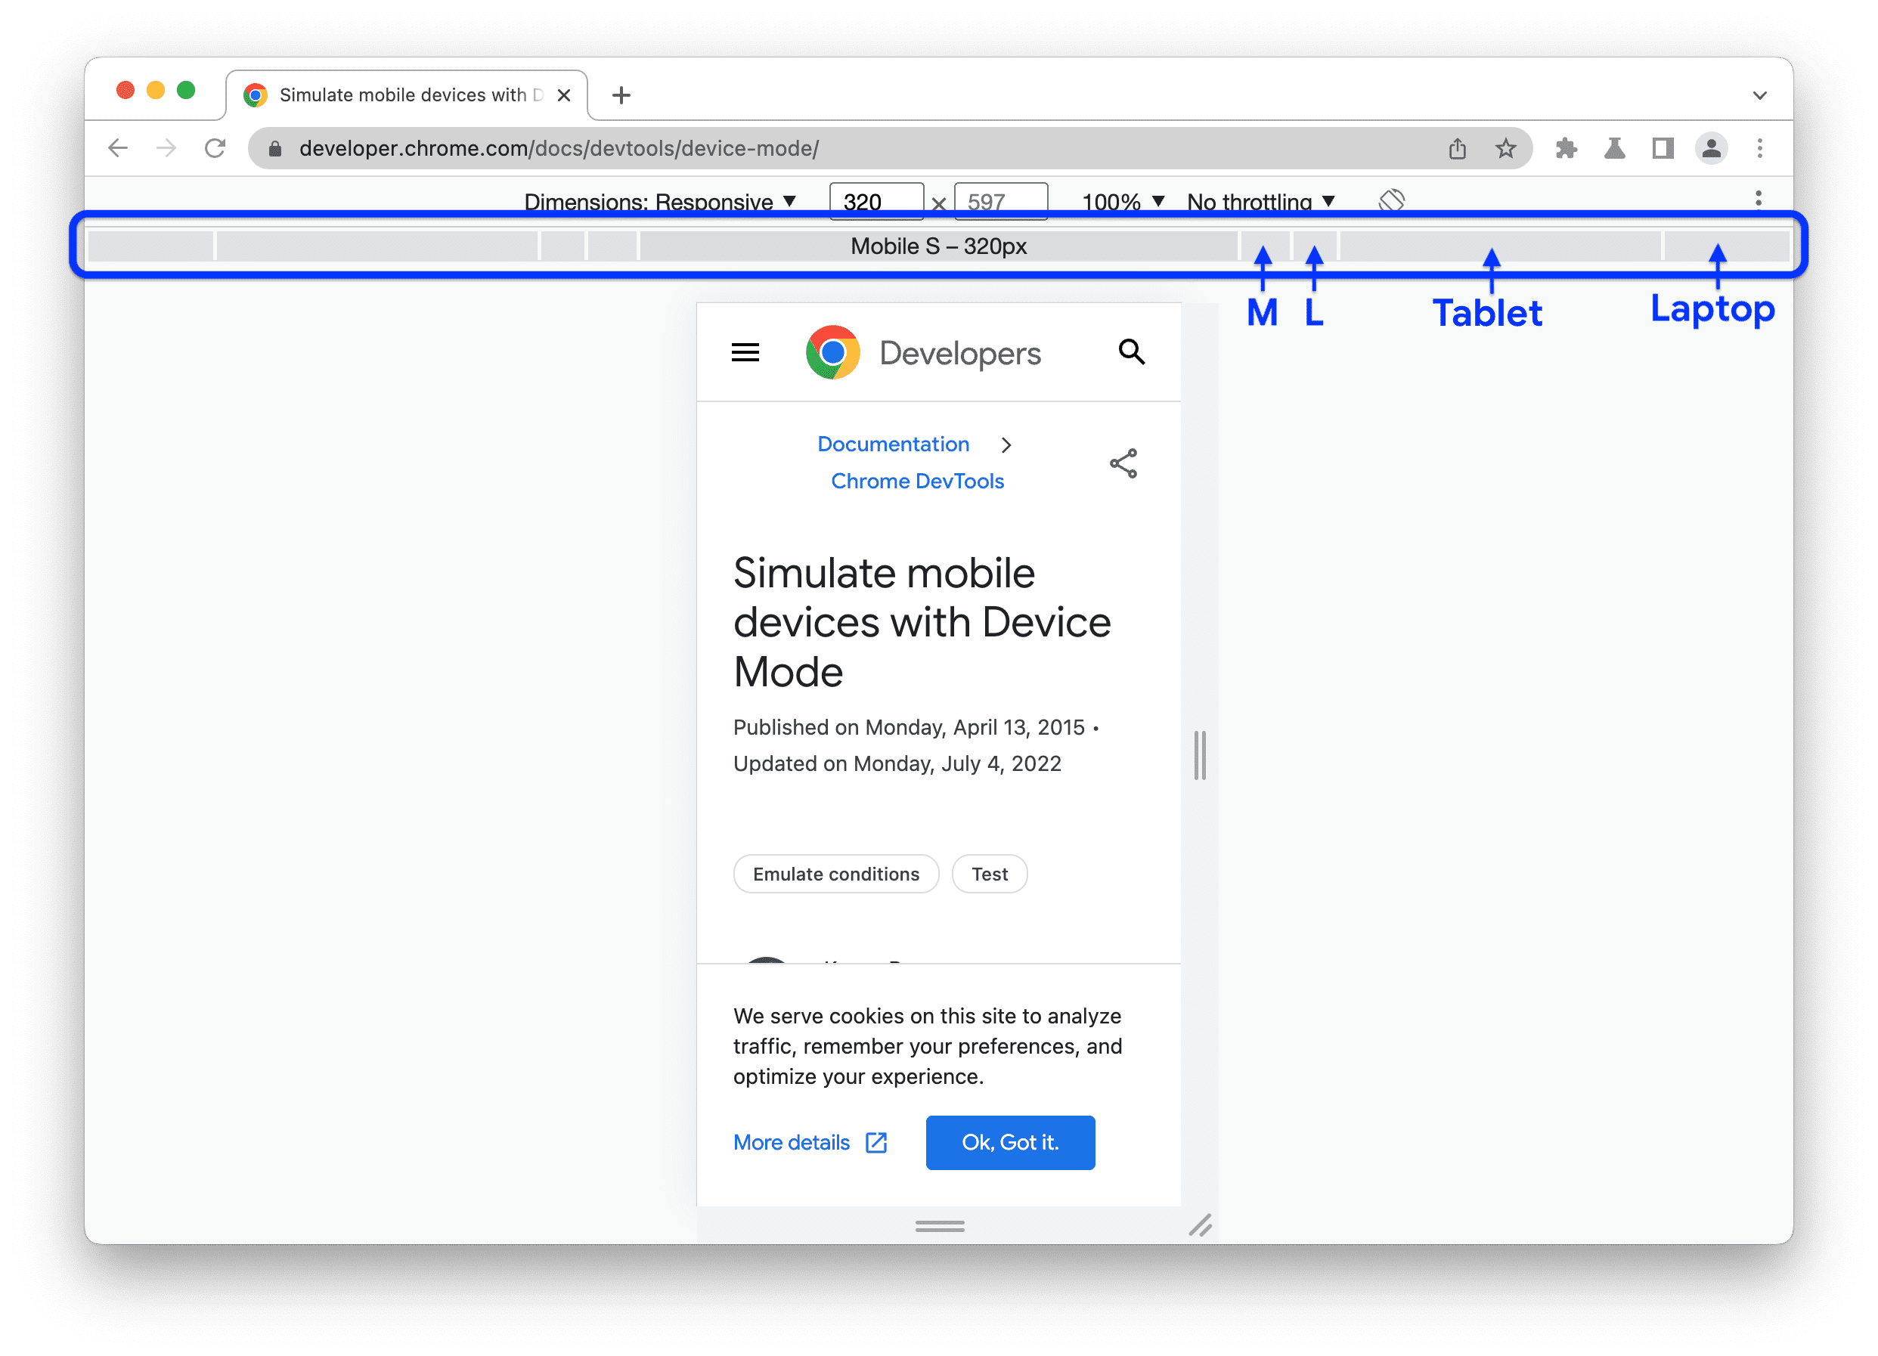
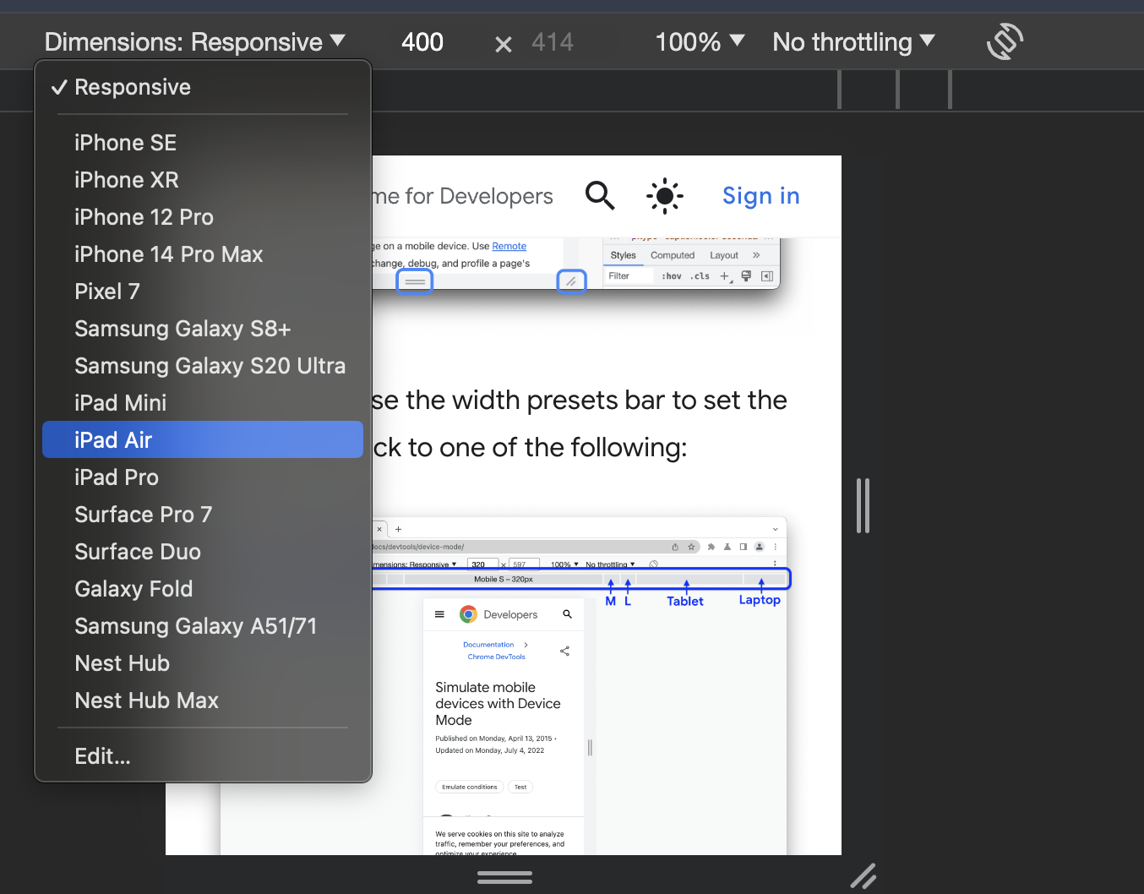
Simulate a Mobile Device

Slide 28
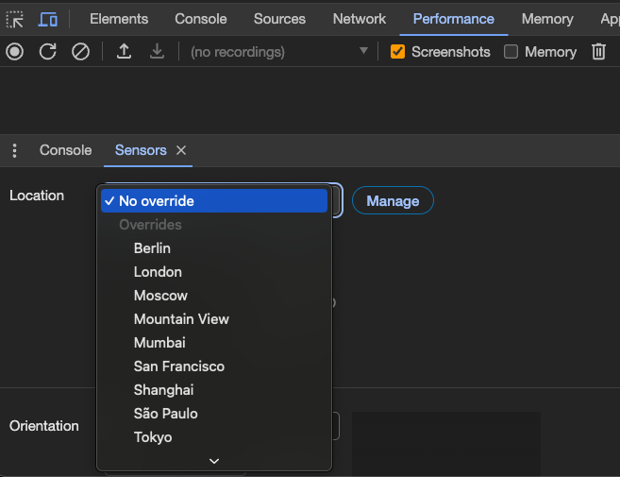
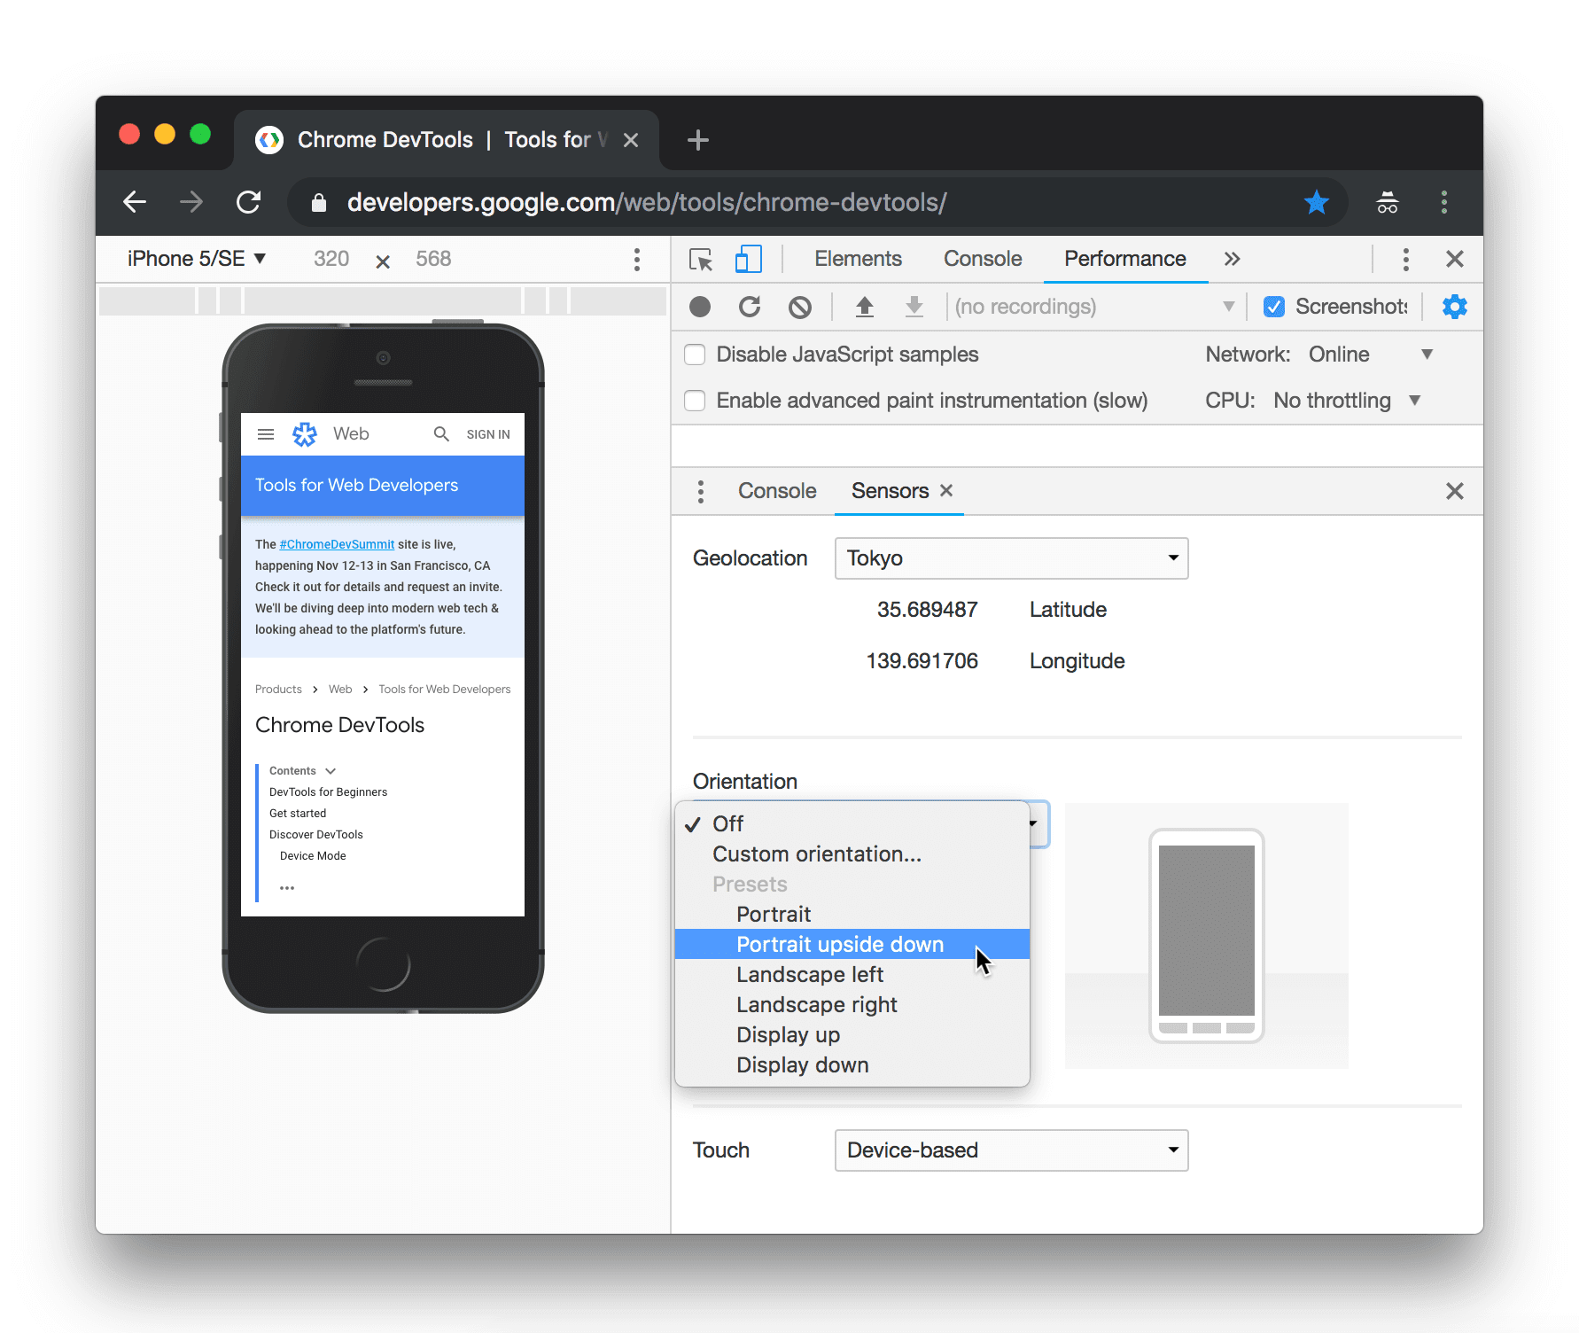
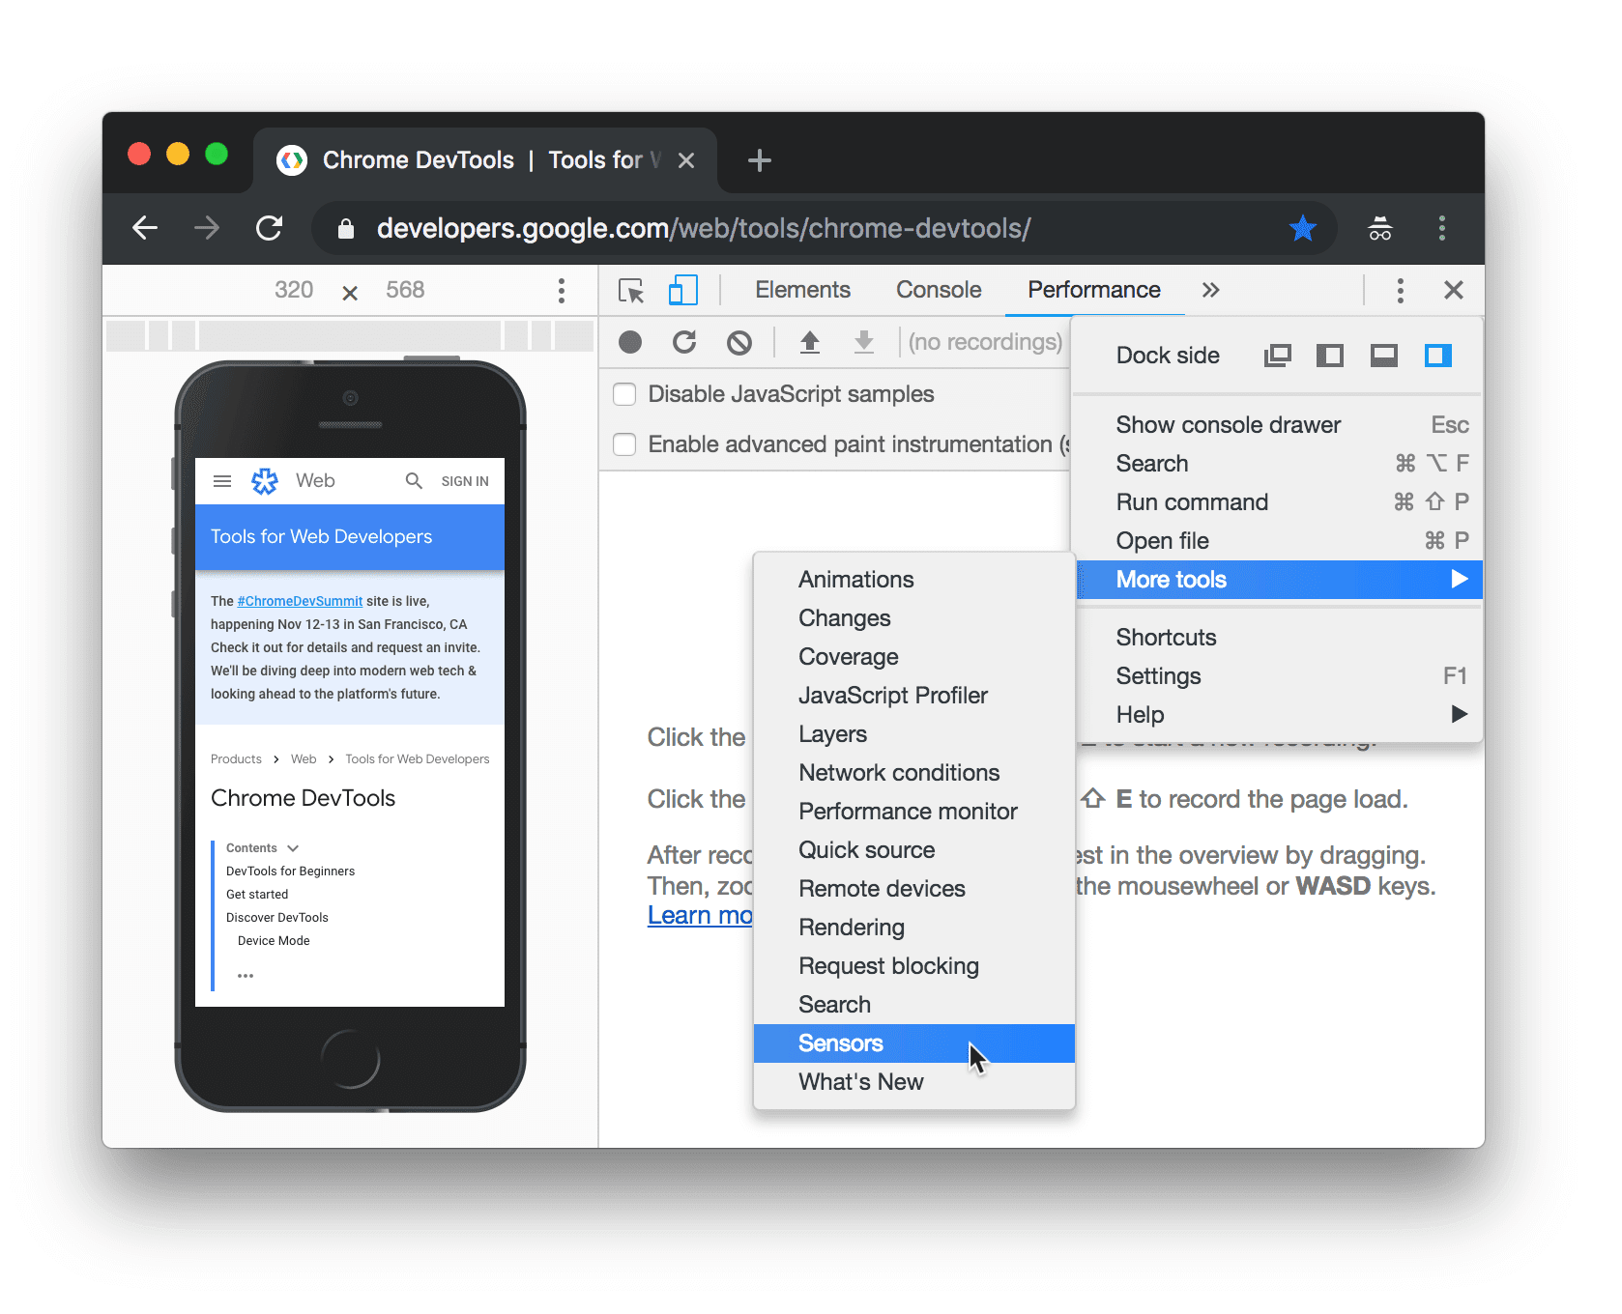
Override Sensors

Slide 29
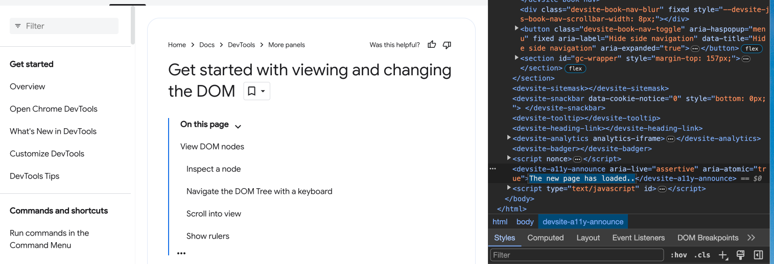
View and Edit your Page.... Live!

Slide 30
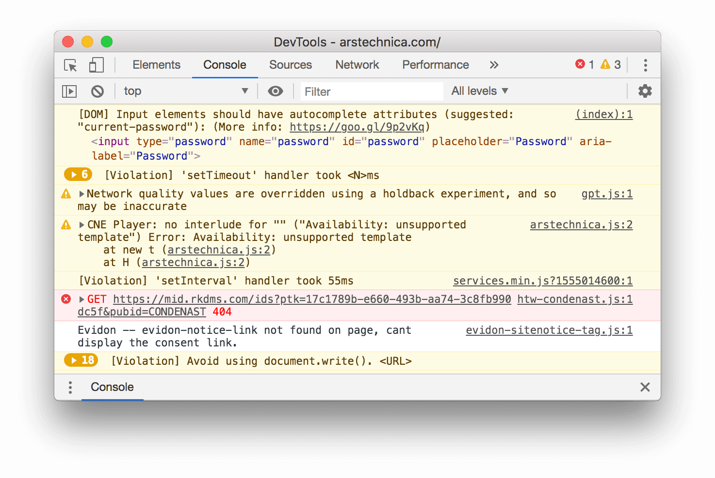
The Console

Slide 31
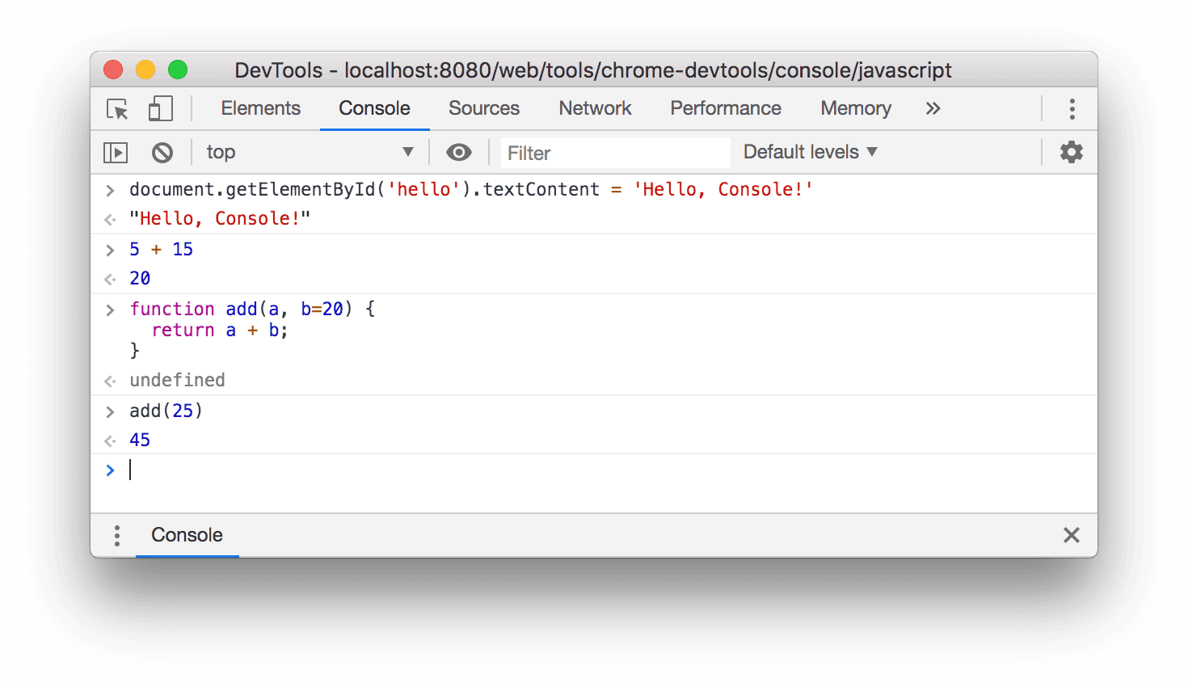
The Console Run Javascript

Slide 32
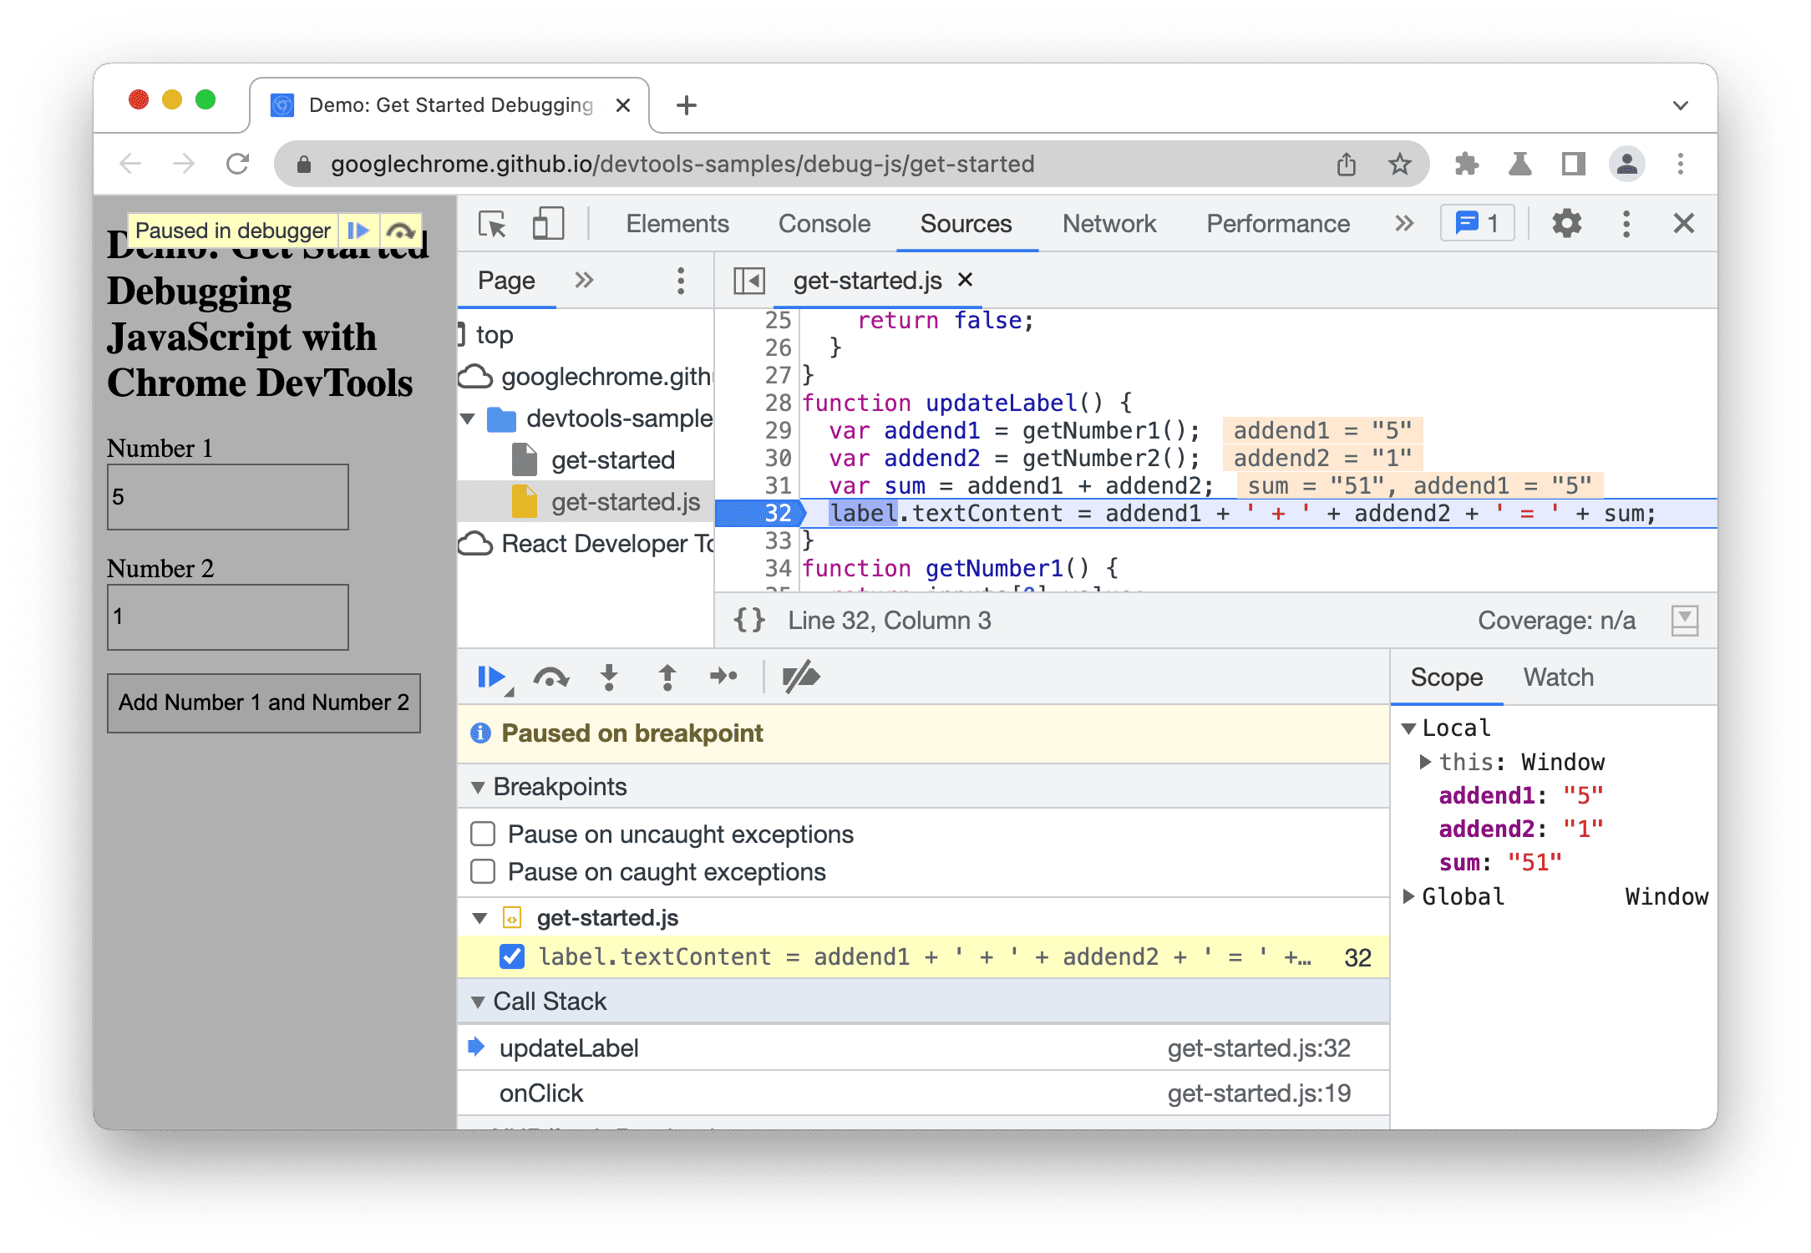
Debug and Stop Live Javascript

Slide 33
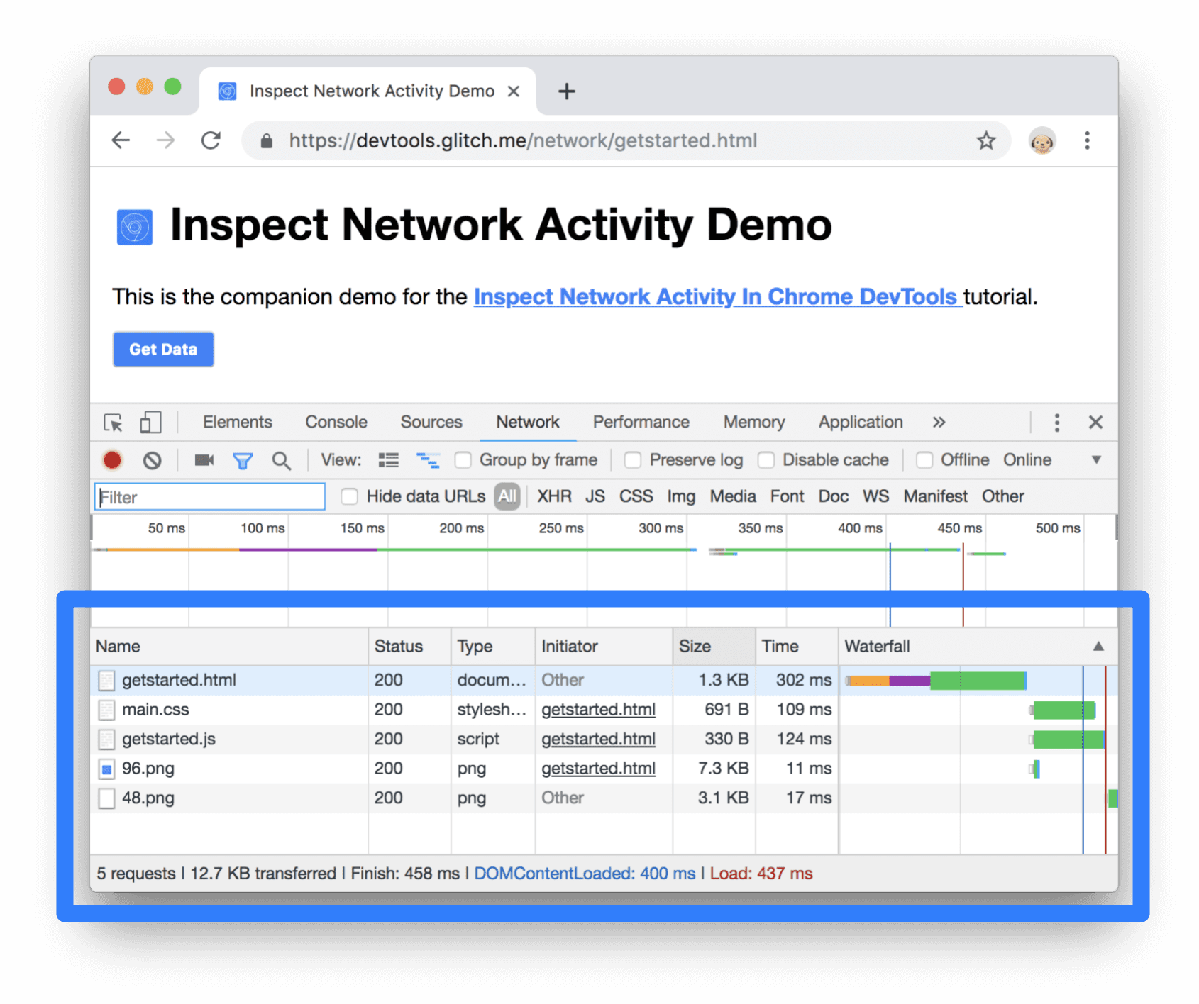
Inspect Network Activity

Slide 34
My website is having issues!
What do you do first?
Check the dev tools console for errors!
Check the dev tools network monitor for slow or failed network requests!
You will do this almost EVERY DAY OF YOUR CAREER (if you are developing web apps that is)

Slide 35

Where does the content come from?
The browser renders HTML and websites from where?

Slide 36

Client Server
Your device, (phone, computer, laptop etc) is the client
The ”Server” can be many things
A computer in the cloud
A computer in the datacenter
Even a computer in someone’s house

Slide 37
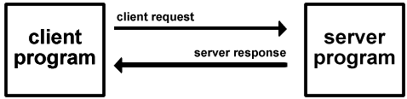
Clients and Servers
Client/Server Computing:
The interaction between two programs when they communicate across a network.
A program at one site sends a request to a program at another site and awaits a response.
The requesting program is called a client; the program satisfying the request is called the server.

Slide 38
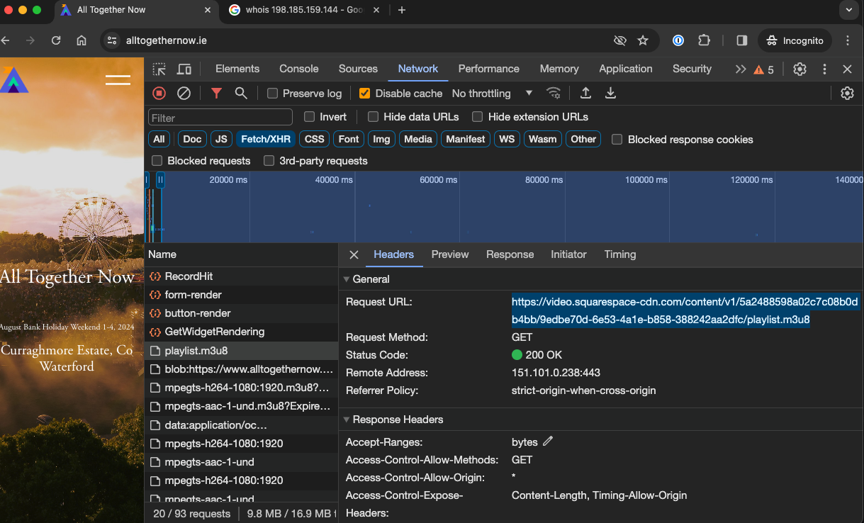
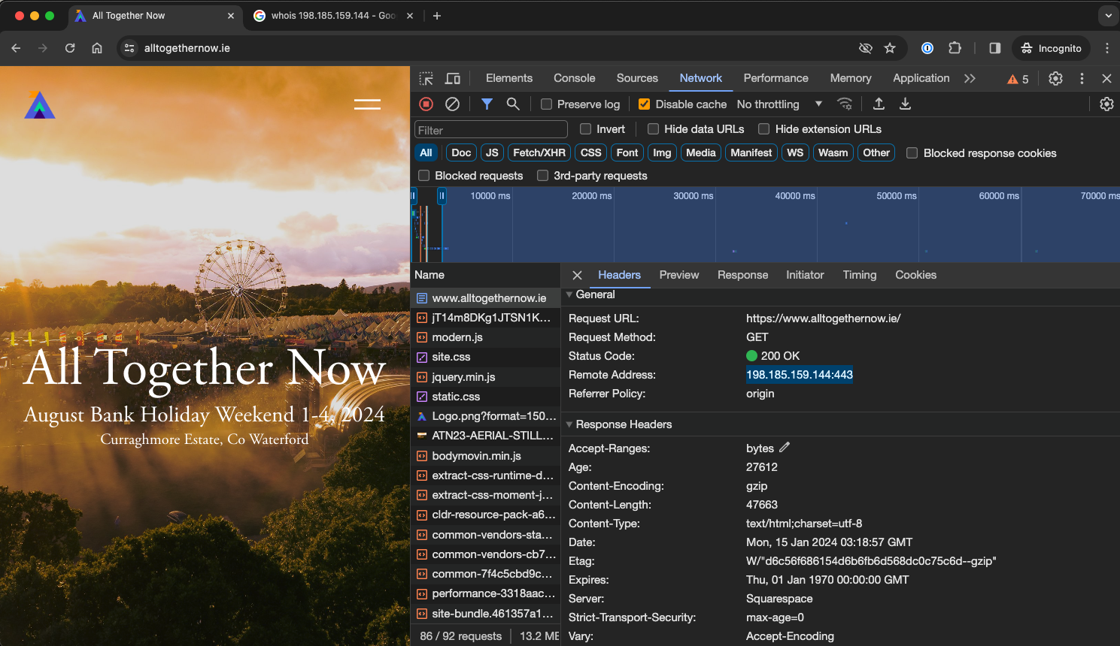
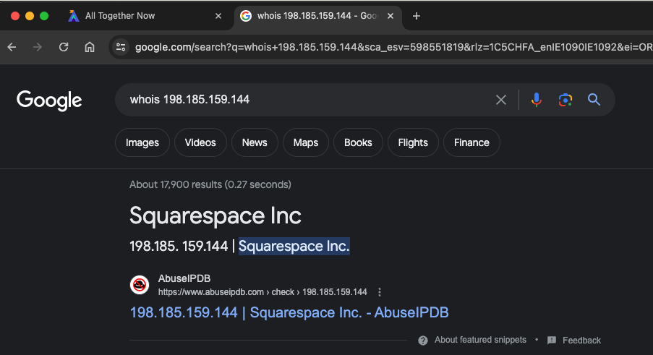
Who is the server?????

Slide 39
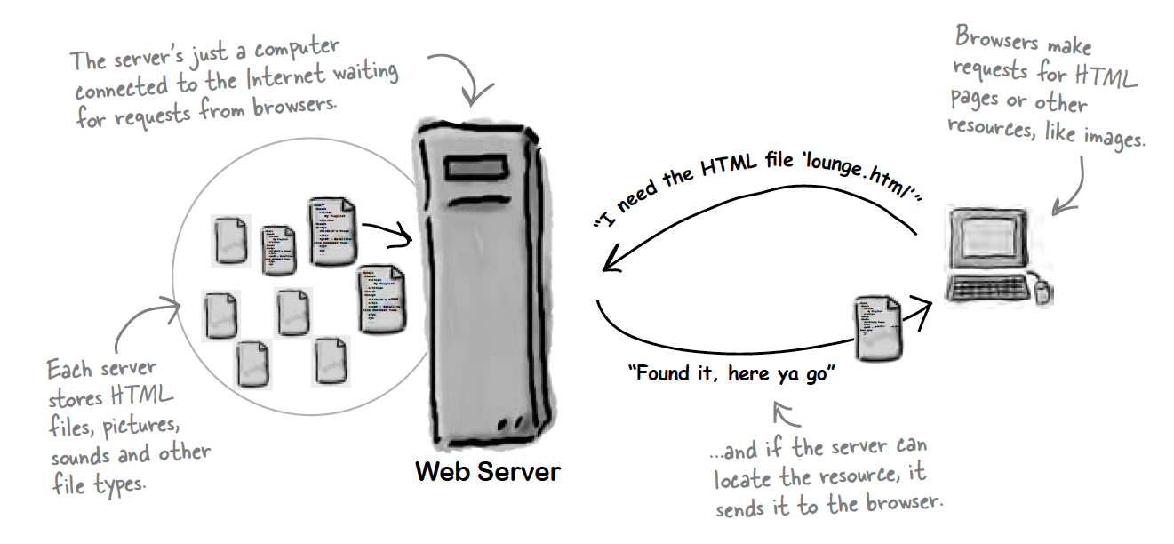
The Server

Slide 40
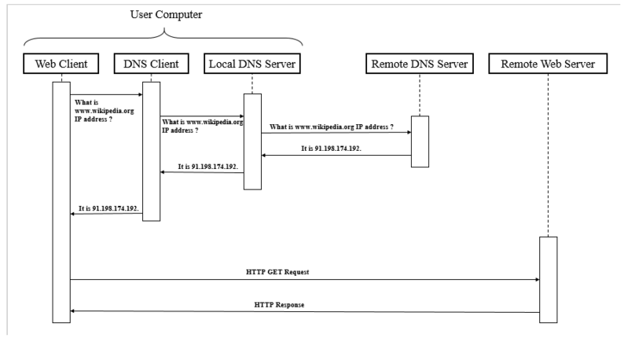
Where did that IP Address come from?
DNS = Domain Name Server or Domain Name System

Slide 41
In Brief (Very much simplified)
When you type in a website into your browser
The name of the website, or URL is resolved by DNS to an IP (Internet Protocol) Address
Your browser now performs a HTTP GET on port 80 or 443 (depending on HTTP and HTTPs) on that IP address
Your browser will download index.html and render it

Slide 42
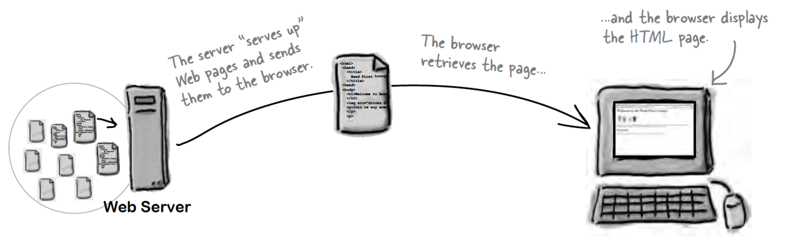

Slide 43
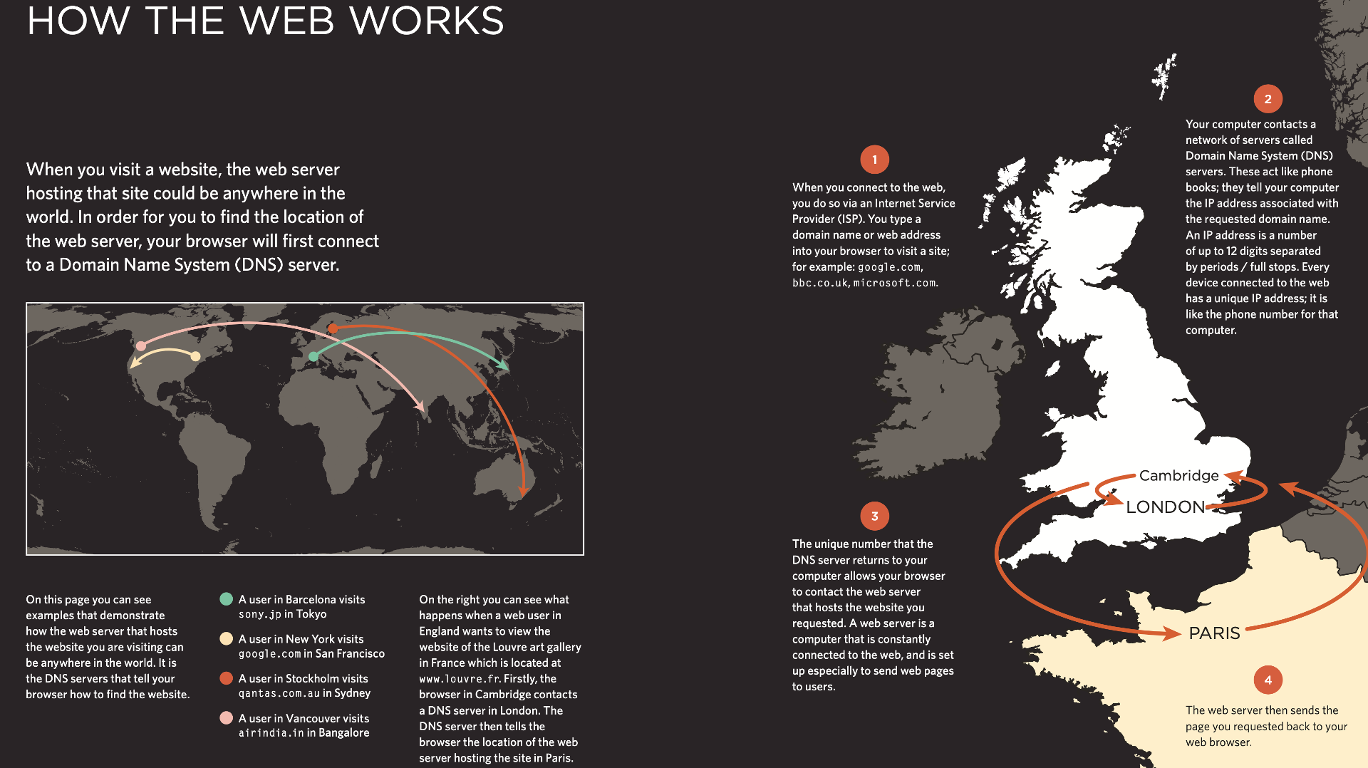

Slide 44
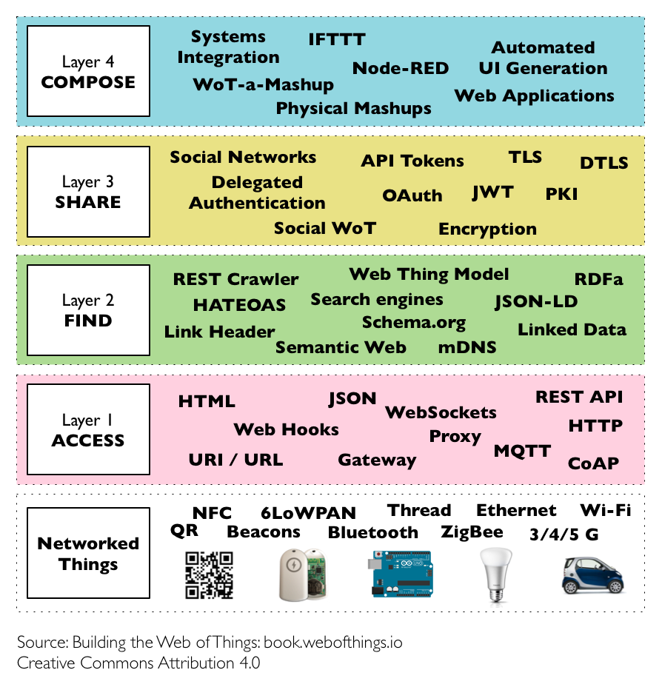
Wait, HTTP?
Protocols & Standards
Protocol : agreed vocabulary to enable two programs to communicate
Standard: an agreed definition of the structure and meaning of a document
Web Protocol
Hyper Text Transfer Protocol - HTTP
Web Standard
Hyper Text Markup Language – HTML
Cascading Style Sheets - CSS
Web Servers and Web Browsers use HTTP to exchange HTML documents

Slide 45

Web 1.0
Web 1.0 is a retronym referring to the first stage of the World Wide Web's evolution, from roughly 1989 to 2004.
"content creators were few in Web 1.0 with the vast majority of users simply acting as consumers of content"
Personal web pages were common, consisting mainly of static pages hosted on ISP-run web servers, or on free web hosting services such as Tripod and the now-defunct GeoCities.

Slide 46
Web 2.0
Web 2.0 (also known as participative (or participatory) web and social web) refers to websites that emphasize user-generated content, ease of use, participatory culture and interoperability (i.e., compatibility with other products, systems, and devices) for end users.

Slide 47
Web 3.0
The Semantic Web, sometimes known as Web 3.0 (not to be confused with Web3), is an extension of the World Wide Web through standards set by the World Wide Web Consortium (W3C).
The goal of the Semantic Web is to make Internet data machine-readable.

Slide 48
But Web3????
Web3 is an idea for a new iteration of the World Wide Web which incorporates concepts such as decentralization, blockchain technologies, and token-based economics.
Some technologists and journalists have contrasted it with Web 2.0, wherein they say data and content are centralized in a small group of companies sometimes referred to as "Big Tech".
The term "Web3" was coined in 2014 by Ethereum co-founder Gavin Wood, and the idea gained interest in 2021 from cryptocurrency enthusiasts, large technology companies, and venture capital firms.
The concepts of Web3 were first represented in 2013

Slide 49
The End of the Beginning
Web Development I

